Slide 1
Web Server Deployment Heroku
-Joshua Gahan
CS431/531 Fall 2018

Slide 2
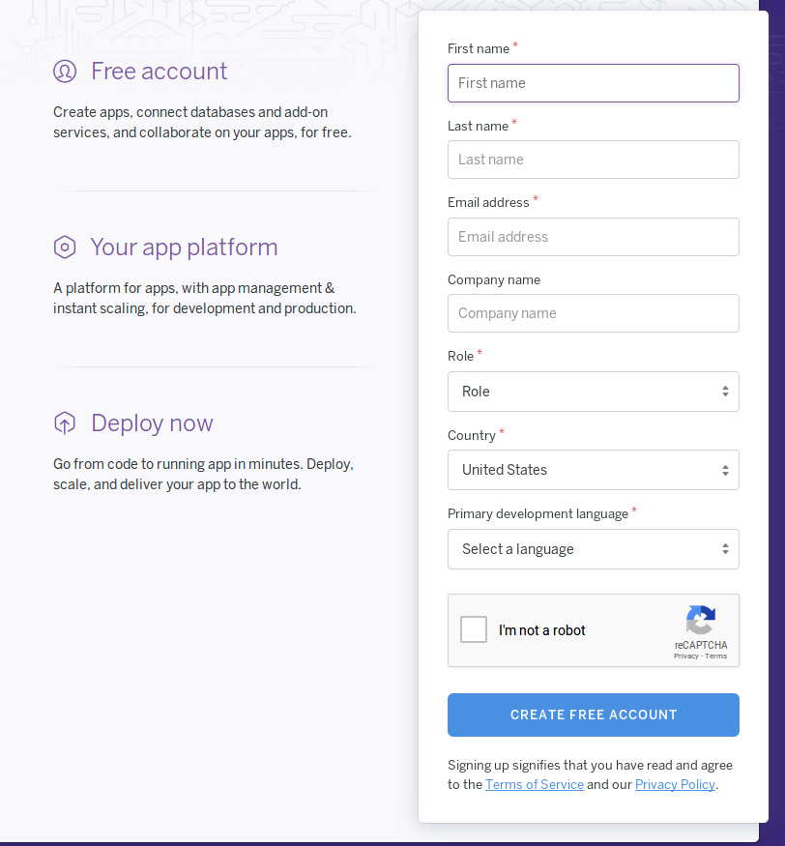
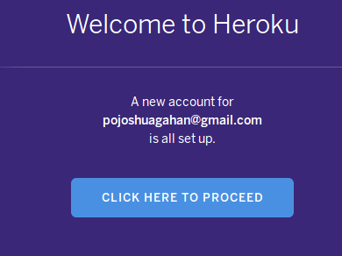
Register for a Heroku account
https://www.heroku.com/free

Slide 3
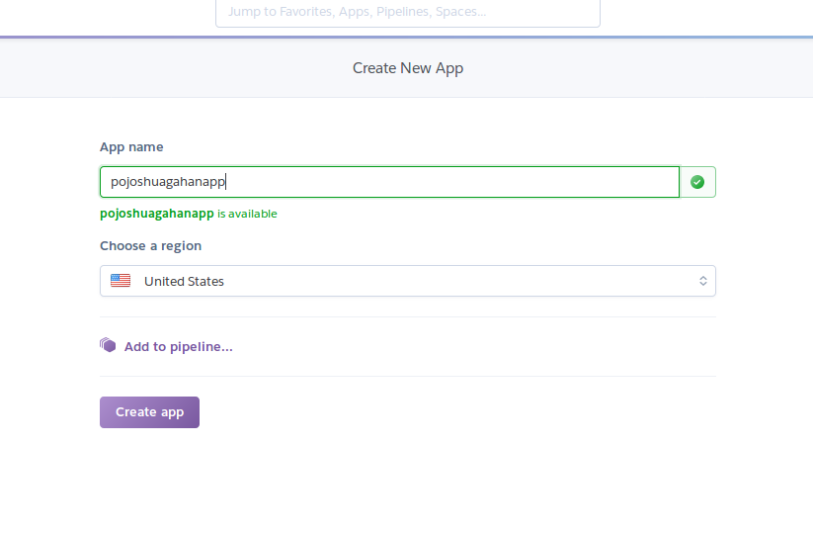
Create a new app

Slide 4
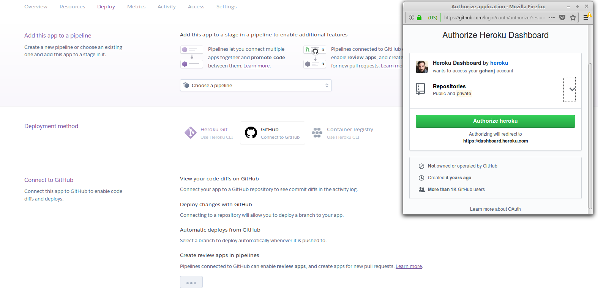
Connect to Github

Slide 5
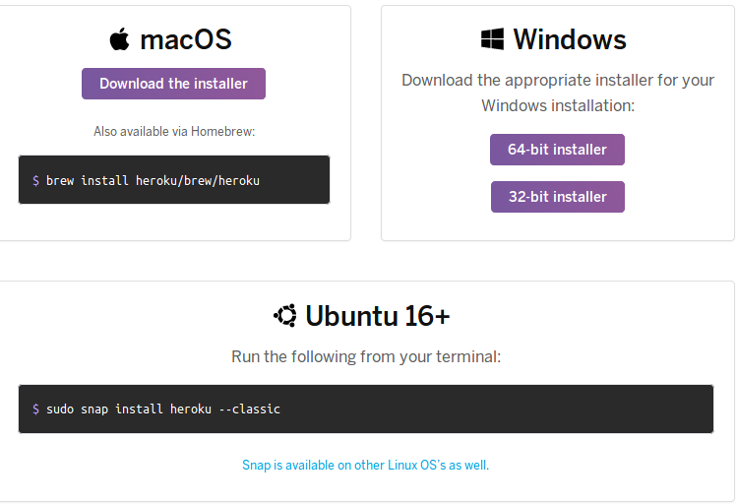
Install Heroku

Slide 6

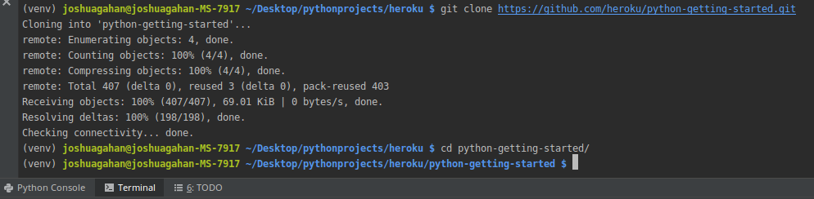
Login to Heroku and clone the ‘getting started.git’ for your language

Slide 7
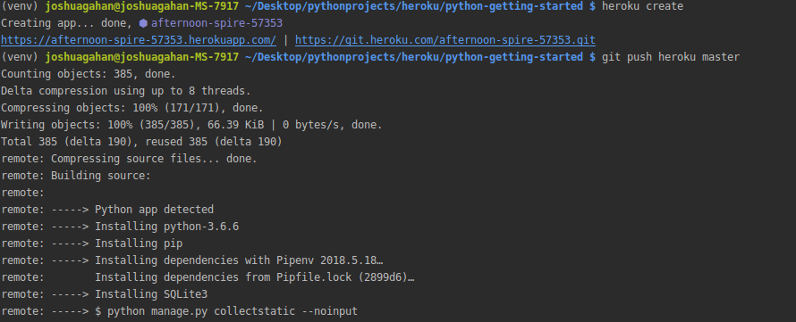
Create heroku app and deploy
*Note during create, you may pass your app name as a parameter, otherwise it will
Assign your app a name (afternoon-spire-57353 in this case)

Slide 8
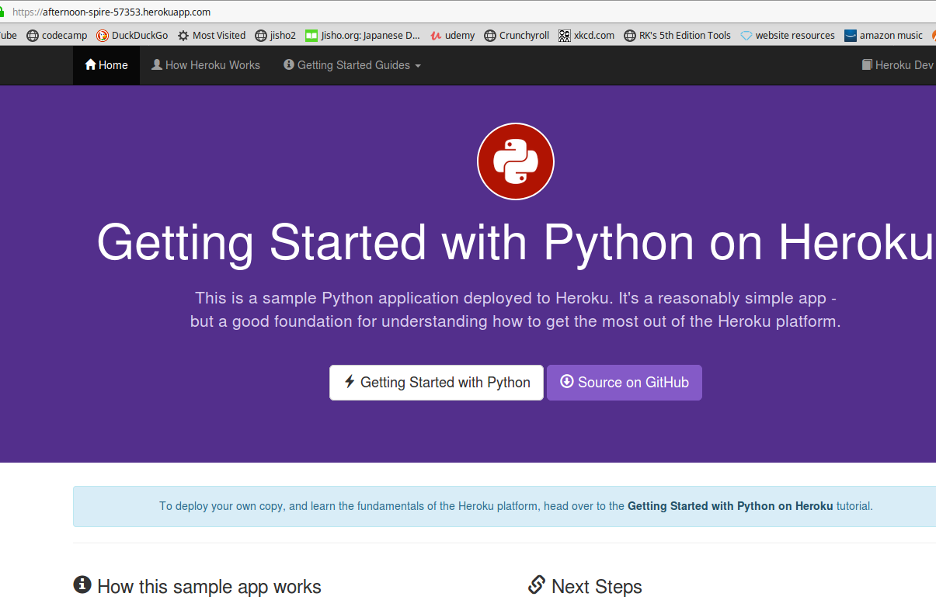
Deployed sample Heroku Server

Slide 9
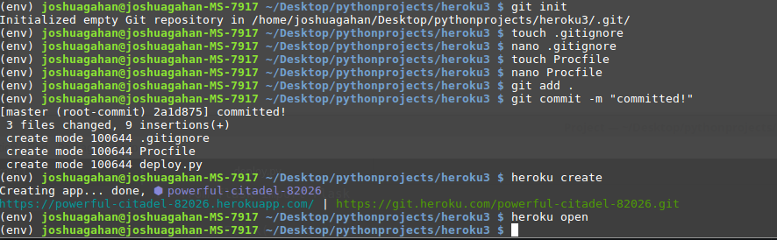
Process is virtually the same w/o the sample project
The Important bits here are the “Procfile” (next slide) and heroku create. Create will create
A link for the app as well as a .git for it.

Slide 10
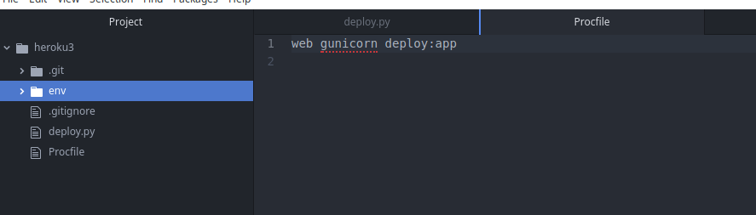
Procfile
Procfile is used by heroku to look for the first instruction to run when loaded (similar to a Dockerfile). In this case we’re using the gunicorn web server to launch our application.

Slide 11
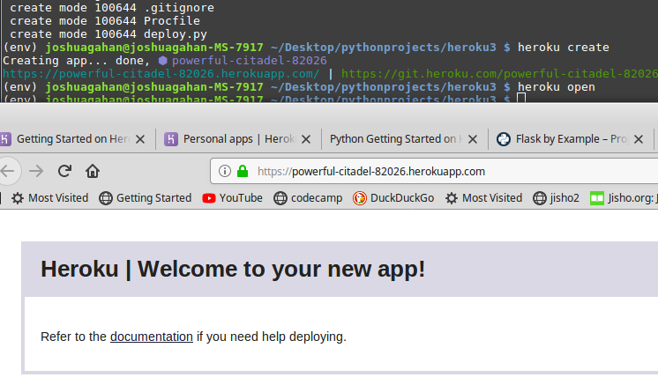
Its Running!

